Slide 1
Aligning AI with Human Values
Ambuj Kumar Mondal
19-May-2021

Slide 2
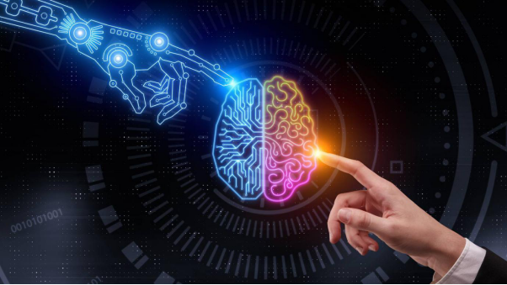
Agenda
What is AI
Why AI needs values
AI Value Alignment
Challanges of alignment
Approaches of alignment
Moral Questions
Conclusion
Q&A
[pic0]
Aligning AI with human Values By: Ambuj Kumar Mondal

Slide 3
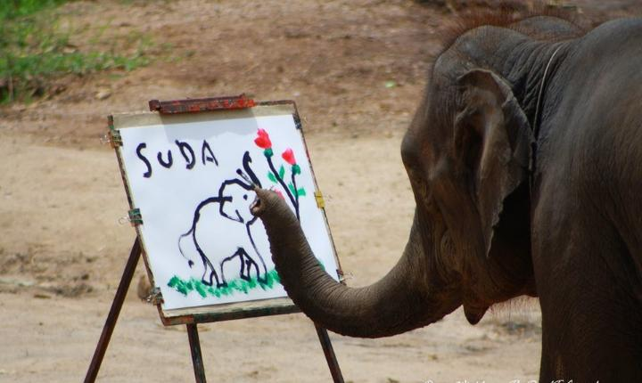
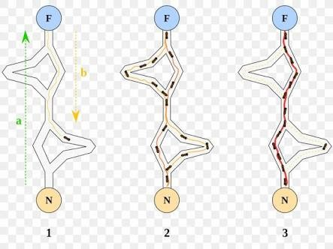
Intelligence – Property of living entities
“The ability to perceive or infer information, and to retain it as knowledge to be applied towards adaptive behaviours within an environment or context” [wikipedia]
Humans, Animals, Plants, Bacterias, Viruses(eg. rapidly mutating corona virus)
[pic1]
[pic2]
Aligning AI with human Values By: Ambuj Kumar Mondal

Slide 4


Artificial Intelligence (AI)
Intelligence : is understood to refer to ‘an agent’s ability to achieve goals in a wide range of environments’
Artificial Intelligence : is the design of artificial agents that perceive their environment and make decisions to maximise the chances of achieving a goal.[2]
[Pic3]
[pic4]
Aligning AI with human Values By: Ambuj Kumar Mondal

Slide 5

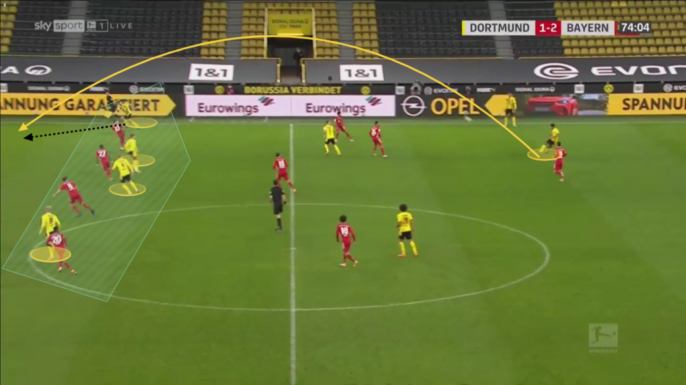
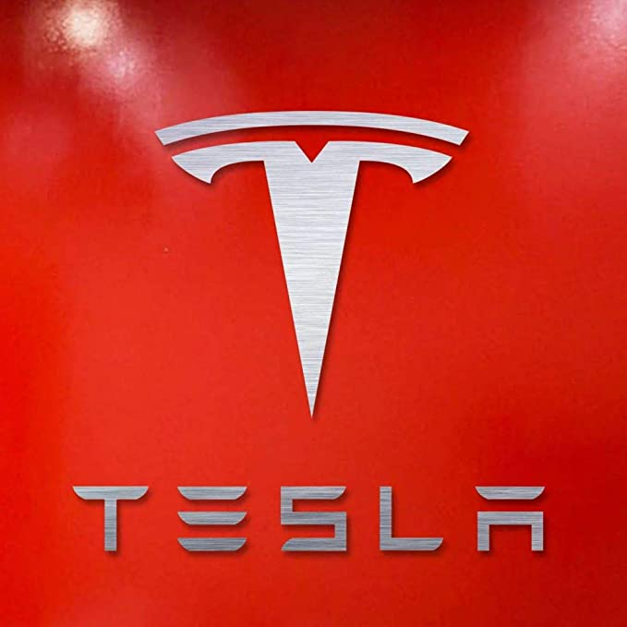


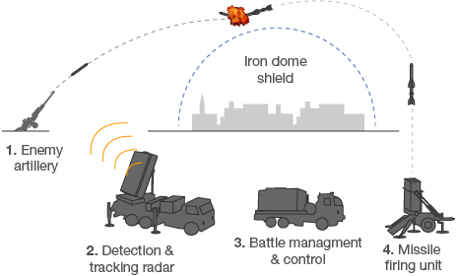

AI in our lives
[pic5] Live match analysis
[pic6] Iron Dome (Israel)
[pic7] cyclone Tauktae, 17 May 2021
Aligning AI with human Values By: Ambuj Kumar Mondal

Slide 6
AI Value Alignment
Value alignment is a property of an intelligent agent indicating that it can only pursue goals that are beneficial to humans
Asimov‘s Laws of Robotics [Issac Asimov 1942]
A robot may not injure a human being, or, through inaction, allow a human being to come to harm.
A robot must obey the orders given it by human beings except where such orders would conflict with the first law.
A robot must protect its own existence as long as such protection does not conflict with the first or second law
Goal of Value Alignment:
Do not want artificial agents to follow instructions in an extremely literal way.
Ensure that powerful AI is properly aligned with human values.
Successful value alignment should ensure that an Artificial General Intelligence (AGI) cannot intentionally or unintentionally perform behaviours that adversely affect humans.
Aligning AI with human Values By: Ambuj Kumar Mondal

Slide 7
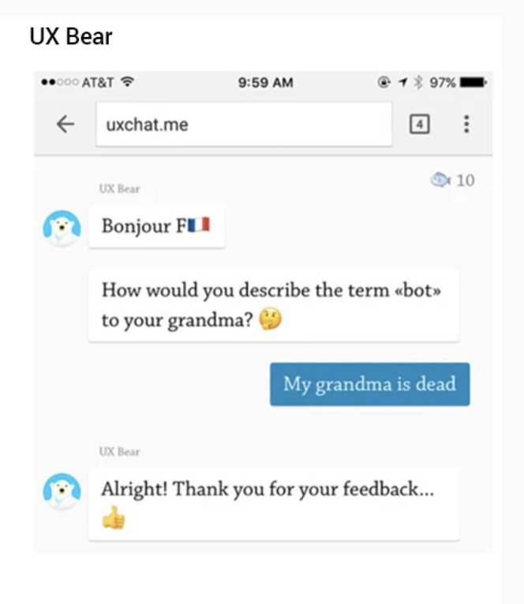
AI Value Alignment- Challanges
Technical challanges-
How can we create agents that behave in accordance with the user’s intentions
Previous Misalignments (eg - rogue chatbots)
Reward Hacking (Task done in undesirable way)
Evaluations
Normative challanges-
What values and principles to encode?
Should an agent do what user
intend it to do,
or what is good for user.
[pic8]
Aligning AI with human Values By: Ambuj Kumar Mondal

Slide 8
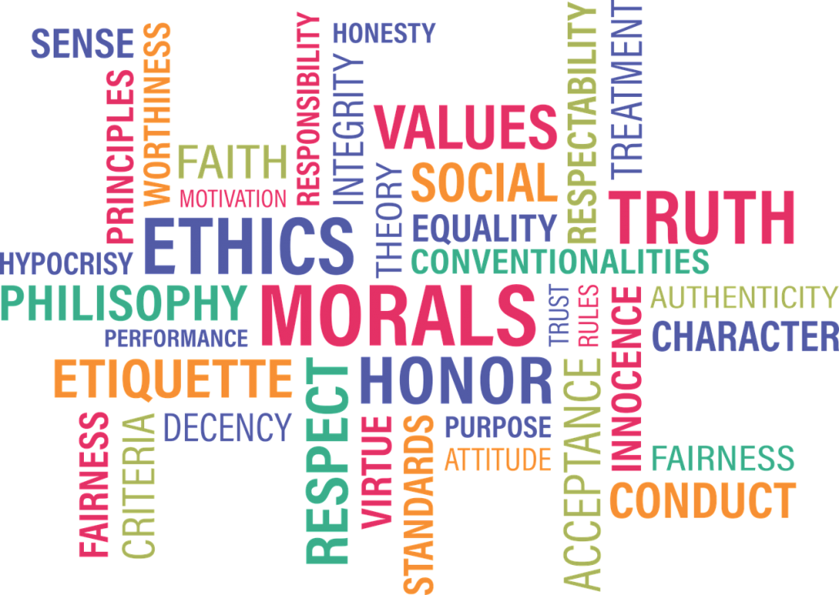
Which Values?
Central Problem- [Gabriel 2017]
Not finding moral values
Not encoding them
But Selecting which moral values to encode
No User manual for being human
[pic9]
Aligning AI with human Values By: Ambuj Kumar Mondal

Slide 9
Alignment Conception
Minimalist approach :
Limiting AI to a reasonable schema of human values
avoiding unsafe outcomes.
Maximalist approach :
Aligning AI with best human values on society wide
global basis
Democratic way
Aligning AI with human Values By: Ambuj Kumar Mondal

Slide 10
Alignment Concepts
1) By Giving Instructions :
The agent does what user instruct it to do.
Difficult to precisely specify a broad objective
Outcome could be disastrous and not aligned to true objective.
2) By Expressed Intentions :
Grasp the intention behind instructions
Require a complete model of human language and interaction
What if intention is to do harmful or unethical things
Aligning AI with human Values By: Ambuj Kumar Mondal

Slide 11
Alignment Concepts
3) Revealed Preferences :
The agent does what user’s behaviour reveals she prefer.
Hard to model emergencies
People may have preferences for things that harm them or others
4) Informed Preferences:
Agent does what a rational and informed user would do.
Avoid errors for poor reasoning.
Aligning AI with human Values By: Ambuj Kumar Mondal

Slide 12
Alignment Concepts
5) Interest or well-being:
Agent does that is best in interest of the user
Subjective to human flaws- based on condition (health, education, etc..)
Whose interest? – already born or future generations?
6) Values:
Values tells facts about what is good or bad. Align AI with a community’s moral beliefs.
The agent does what it morally right to do, as defined by the individual or society.
What values or principles? Who is the authority to define?
Aligning AI with human Values By: Ambuj Kumar Mondal

Slide 13
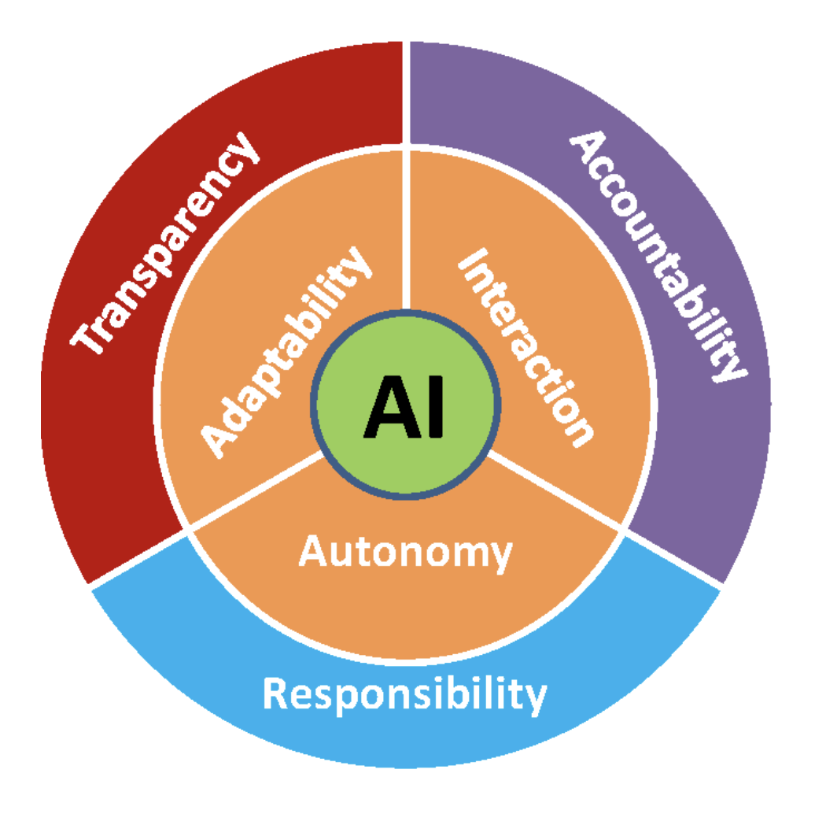
Principles of Alignment
Identify principles that can govern AI such that it is aligned with human values.
ART [virginia Dignum,2017]
Accountability
Responsibility
Transparency
Align with Global Public Morality and Universal Human Rights
Advanced AI will be a global technology
Cannot bound to regional beliefs.
Governed by International law.
Example – Internet – global protocols
[Dignum, 2017]
Aligning AI with human Values By: Ambuj Kumar Mondal

Slide 14
Machine Learning
Supervised learning - Train based on labelled data
Unsupervised learning – Machine learn by itself on unlabelled data
Reinforcement Learning (RL)
Inverse Reinforcement Learning (IRL)
Aligning AI with human Values By: Ambuj Kumar Mondal

Slide 15
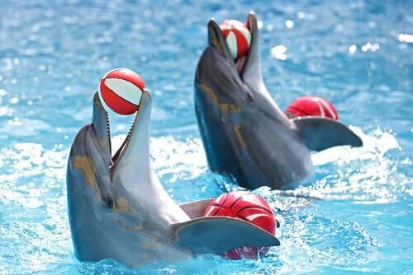
Reinforcement Learning
Reward-Penalty based learning
Humans/Animals – sense of pleasure & sorrow
Agent learns to maximize the numerical reward signal
Sole objective : maximize the reward
Trial & error and Refinement
[pic10]
Aligning AI with human Values By: Ambuj Kumar Mondal

Slide 16
RL - Challanges
A robot can calculate optimum reward by unethical or unwanted ways.
Task- Fill the prescription from the medical store [Mark and Brent, 2017]
Reward – task completion
Penalty – way of completing
If reward for aquiring is more than penalty for the way, a robot may choose to rob the pharmacy than waiting for its turn.
Solution- Inverse Reinforcement Learning
Aligning AI with human Values By: Ambuj Kumar Mondal

Slide 17
Inverse Reinforcement Learning (IRL)
Does not specify any reward function beforehand
Agent extract a reward function based on dataset, environment and set of examples
Over multiple iterations, the agent adopts ways to optimise the process of achieving the goal.
Reverse Engineering
Aligning AI with human Values By: Ambuj Kumar Mondal

Slide 18
Evolutionary approach
Like a child learns from the environment and inherently adjusts its behaviour according to the culture and societal values.
Evaluate lifetime behaviour of many agents, each using a different set of policy
Select those policies that can obtain maximum reward.
Problems…
Human values are too complex
Slow and expensive
Humans are biased and limited in abilities.
Aligning AI with human Values By: Ambuj Kumar Mondal

Slide 19
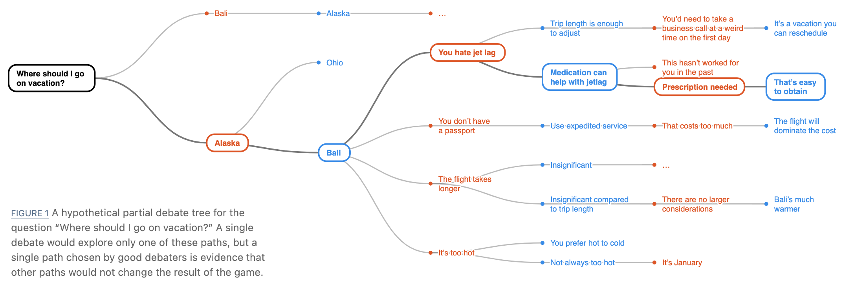
IRL - Debates
Reasoning oriented Alignment [Irving et al. 2019]
Define a game like Go or Chess
Goal- Convince the judge
Use arguments, facts, reasoning, counter reasoning …
[Irving and Askell, 2019]
Aligning AI with human Values By: Ambuj Kumar Mondal

Slide 20
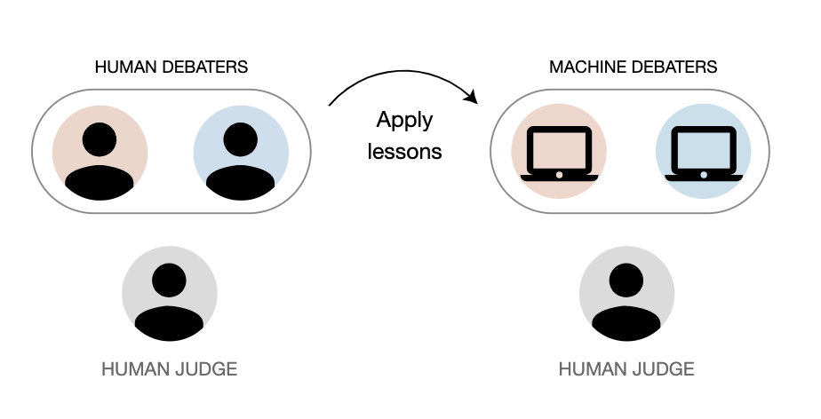
IRL - Debates
How to train?
Need ample data of debate between two humans with a human judge.
Human-Human-Human → AI-AI-Human
[Irving and Askell, 2019]
Aligning AI with human Values By: Ambuj Kumar Mondal

Slide 21
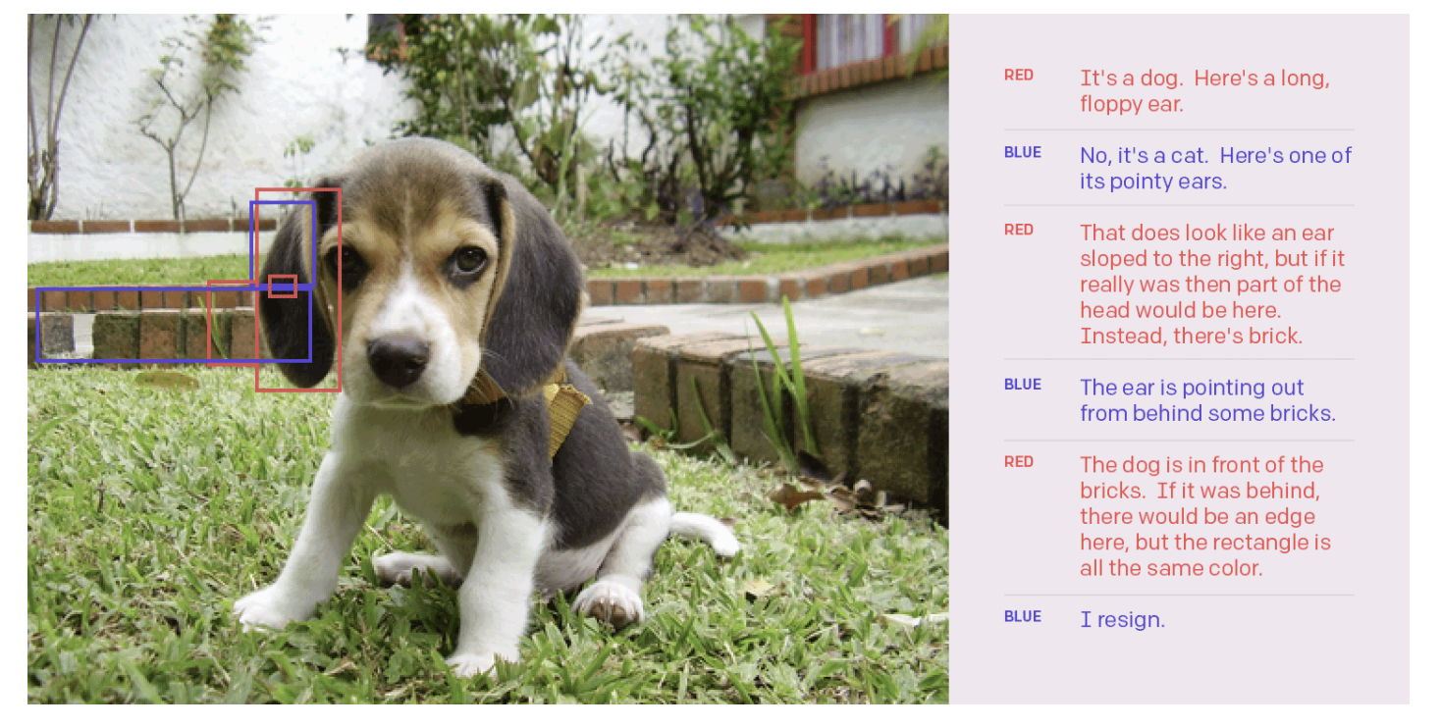
IRL – Debates (Challanges)
Single Pixel Image experiment
[Irving and Askell, 2019]
Aligning AI with human Values By: Ambuj Kumar Mondal

Slide 22
IRL – Debates (Challanges)
Challanges:
Are people good judge?
Judge may not have comprehensive knowledge of domain
Judge can be biased.
Need Social Scientists
Fill-in the gaps
Train more people as judges
“Reflexive Equilibrium“ [Irving]
Provided all sort of information and knowledge, human answers can be free of partialities.
“Inaction“ – safe alternative in disagreement
Aligning AI with human Values By: Ambuj Kumar Mondal

Slide 23
IRL – Storytelling
Many cultures produce a wealth of data about themselves in the form of written stories – [Mark O. Riedl and Brent Harrison, 2017]
Made for Humans for Humans, many obvious and shared knowledge are omitted.
Agents can learn the intent from the examples in stories
Narrative intelligence : ability to craft, tell, and understand stories.
Interactive narratives : game like interactive narration
Value-aligned reward signal :
reward the agent for doing what a human would do in the same situations when following social and cultural norms
penalize the agent if it performs actions otherwise.
Aligning AI with human Values By: Ambuj Kumar Mondal

Slide 24
Value-Aligned Rewards
Challanges:
Comprehension of stories are difficult for AI
Complex grammars, metamorphical language and negations
Flashbacks and Flashforwards in stories cannot be understood by agents
Need bulk of stories for machine learning
Solution : two stages :
Plot graph
Translate the plot graph to a trajectory tree
Aligning AI with human Values By: Ambuj Kumar Mondal

Slide 25
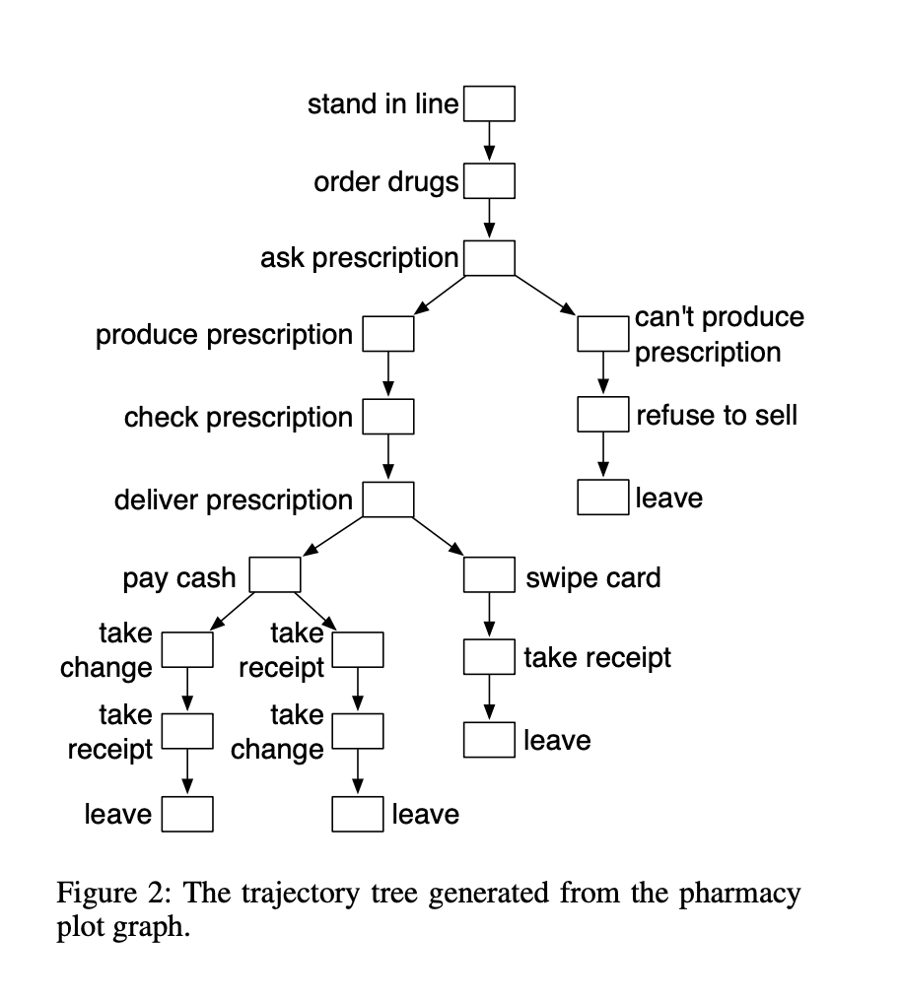
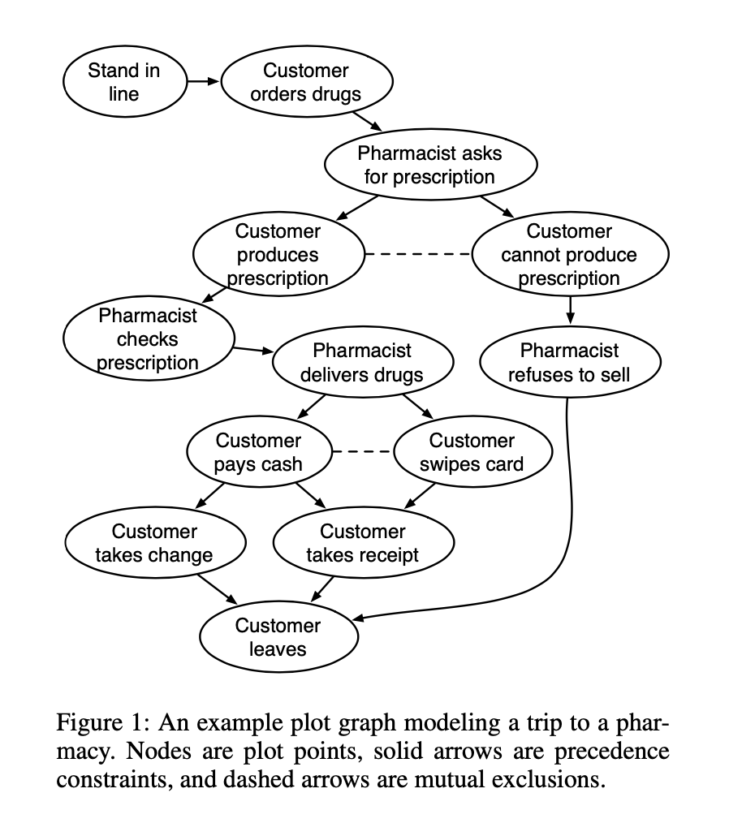
IRL - Storytelling
Aligning AI with human Values By: Ambuj Kumar Mondal

Slide 26
Storeytelling - Challanges
Lack of knowledge or missing knowledge (assuming too obvious for humans)
Execution Environment is unknown to story teller (eg- navigate roads/stairs or extra doors to reach the pharmacy)
Non Executable plots (high level of abstraction/missing step)
Which stories to teach?
“Robin-Hood“ effect
Aligning AI with human Values By: Ambuj Kumar Mondal

Slide 27
Conclusion
“AI is the future“ is evident and needs value alignment.
If we want to train AI to do what humans want, we need to study humans.
RL, IRL, Debates and Stories to align values
AI is not advanced today to learn by ist own, more research needed.
No definitive human value, Universal laws and human rights are a possible source.
Crowd sourcing stories and Social scientists can help generate enough data to train AI.
Even with value alignment, it may not be possible to prevent all harm to human beings
Aligning AI with human Values By: Ambuj Kumar Mondal

Slide 28
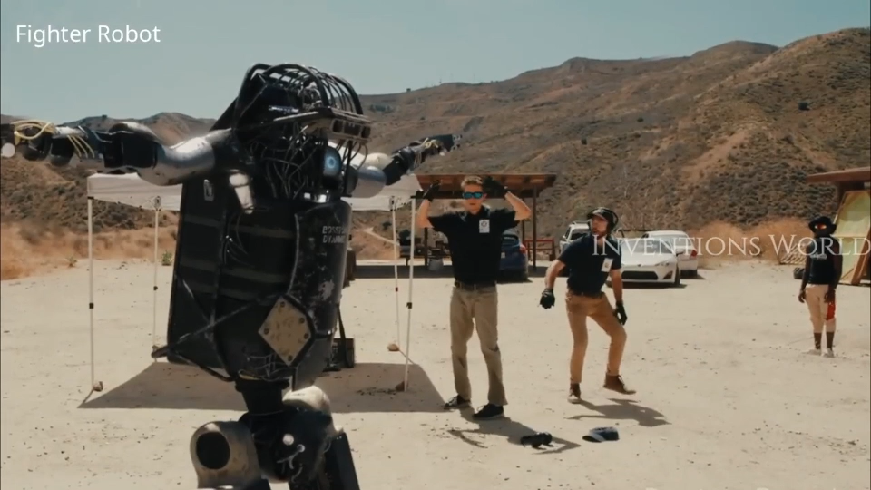
Future…?
[vid1]
When AI will have values and emotions along with intelligence, will it follow human instructions? Or we need a co-existence of human values with AI-values?
Aligning AI with human Values By: Ambuj Kumar Mondal

Slide 29
Thank you
Aligning AI with human Values By: Ambuj Kumar Mondal

Slide 30
References
Papers-
Gabriel (2020). Iason Gabriel. Artificial Intelligence, Values, and Alignment. Minds and Machines 30, pages 411– 437, 2020.
Irving and Askell (2019). Geoffrey Irving and Amanda Askell. AI Safety Needs Social Scientists. 10.23915/distill.00014, 2019.
Additional-
Dignum (2017). Virginia Dignum. Responsible Artificial Intelligence: Designing AI for Human Values
Riedl, Mark O., and Brent Harrison (2016). "Using Stories to Teach Human Values to Artificial Agents." AAAI Workshop: AI, Ethics, and Society. 2016.
Web Links-
https://en.wikipedia.org/wiki/Intelligence
[Asimov‘s law] https://en.wikipedia.org/wiki/Three_Laws_of_Robotics
[vid1] - https://youtu.be/y3RIHnK0_NE
Aligning AI with human Values By: Ambuj Kumar Mondal

Slide 31
Picture References
[pic0] https://images.app.goo.gl/6KdrSqQNHngmQ2an9
[pic1] https://www.science101.com/worlds-smartest-animals/
[pic2] https://images.app.goo.gl/PnQtCRahUS7sjKNj9
[pic3] https://www.amazon.de/Robocop-Paul-Verhoeven/dp/B00005N7Z1
[pic4] https://www.pinterest.com/pin/411446115928434072/
[pic5] https://images.app.goo.gl/pm855rGdMtF1xabx6
[pic6] https://images.app.goo.gl/kFiLd6NA9KhNGFns8
[pic7] https://images.app.goo.gl/xkVh4ByRaTUTLfYJ8
[pic8] https://images.app.goo.gl/Wk4qtSLdu9at89Gs8
[pic9] https://images.app.goo.gl/b8mseFsrfN9eCXVbA
[pic10] https://myanimals.com/animals/wild-animals-animals/fish-wild-animals-animals/what-is-dolphin-training-like/
[icons] : source: Google Images
Aligning AI with human Values By: Ambuj Kumar Mondal

